Slide 1

Milestone 3.2: Interim Showcase
By Melina and Ioannis

Slide 2
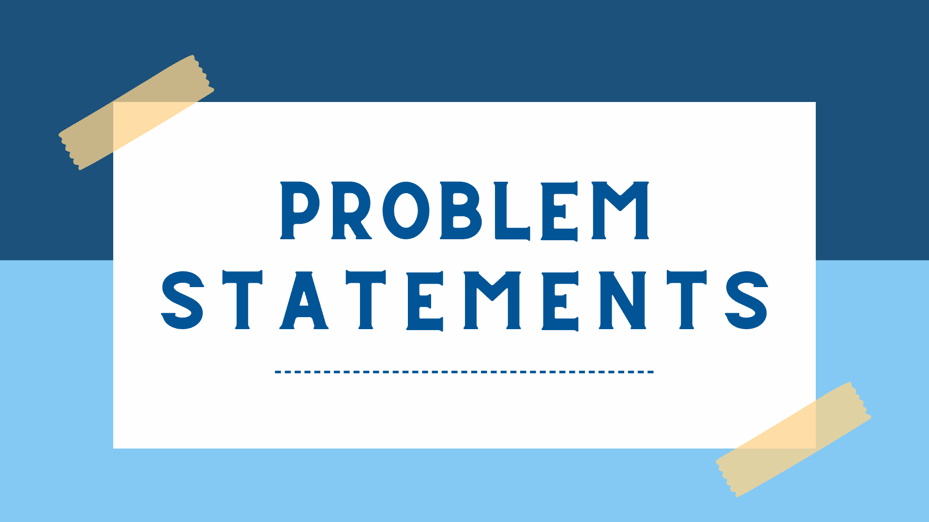
Problem Statement
Health issues like heart disease, diabetes, and obesity are on a rise, and understanding how life choices impact these conditions are more important than ever. This matters as early prediction of health risks is crucial and can help people make better choices and lead healthier lives.
It is commonly known in medicine that prevention is better than cure!

Slide 3
Strategies to take on the project
1.Data cleaning
Data cleaning
Data cleaning
2.Exploratory Data Analysis
Missing values and normalisation of life-related variables.
Exploring relationships between lifestyle factors and health outcomes.
3.Feature Engineering
Data cleaning
Data cleaning
4.Modelling
Aggregate health indices, lifestyle scores and demographic pro.
Logistic regression, k-Nearest Neighbours (kNN), tree-based models.
Data cleaning
Data cleaning
5.Evaluation
6.Insights
Use of precision, recall, and ROC-AUC as performance metrics.
Identifying major lifestyle factors and suggesting preventive measures.

Slide 4

What we’ve done with Python so far

Slide 5
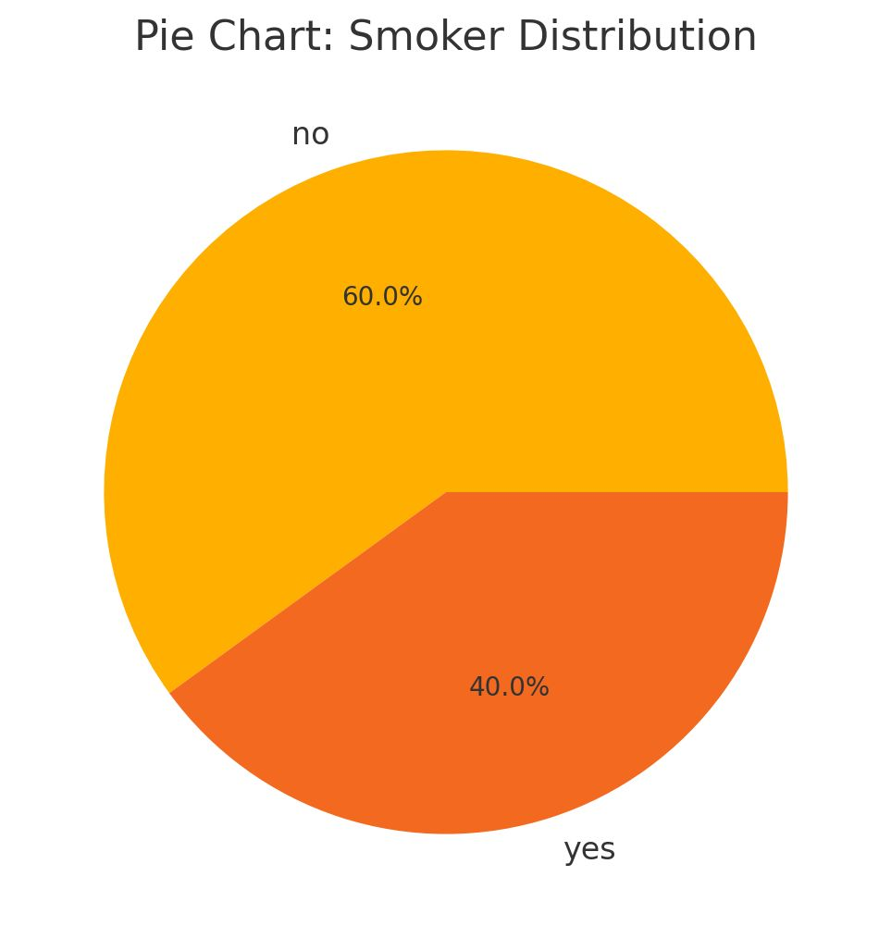
Smoker Distribution
This pie chart accurately states the percentage of people that smoke according to the data set.
Advantages:
Simple and easy to comprehend.
Important to base interpretation of data.
Disadvantages:
Doesn’t portray any information about sex, age, height, weight and any health conditions.

Slide 6
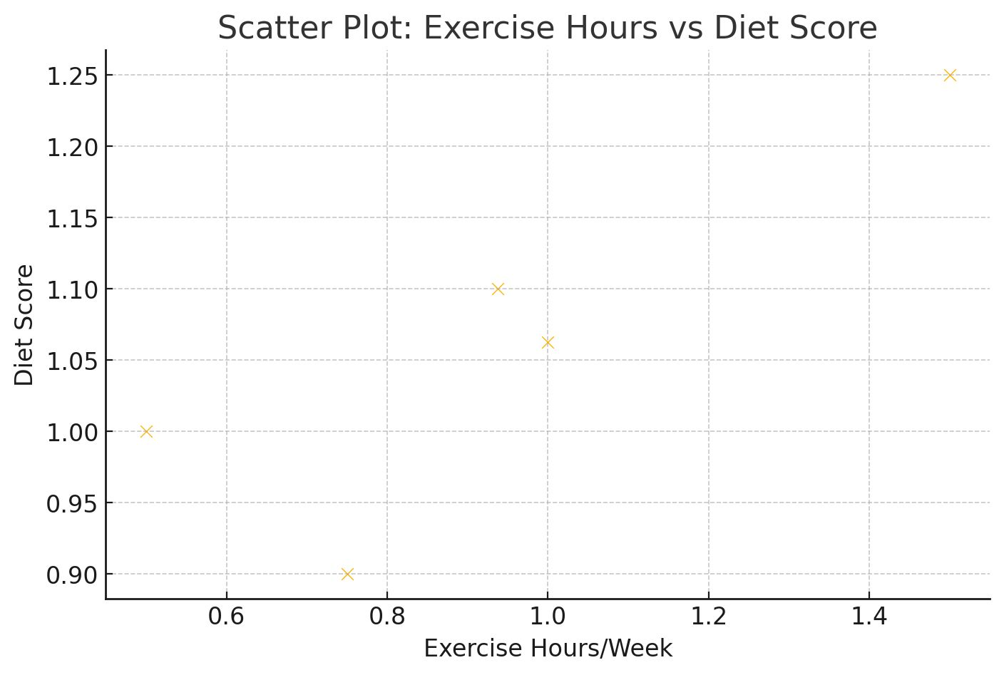
Scatter Plot: Exercise Hours vs Diet Score
Each single data point represents a human being and is plotted in a scatter plot to represent how exercise is correlating to diet score. From healthy people we expect to obtain that they have both higher exercise hours and diet scores.
This is extremely advantageous as many anomalies can be easily spotted throughout the scatter plot. Furthermore, correlations will be depicted easily and lead us to an overall conclusion.

Slide 7
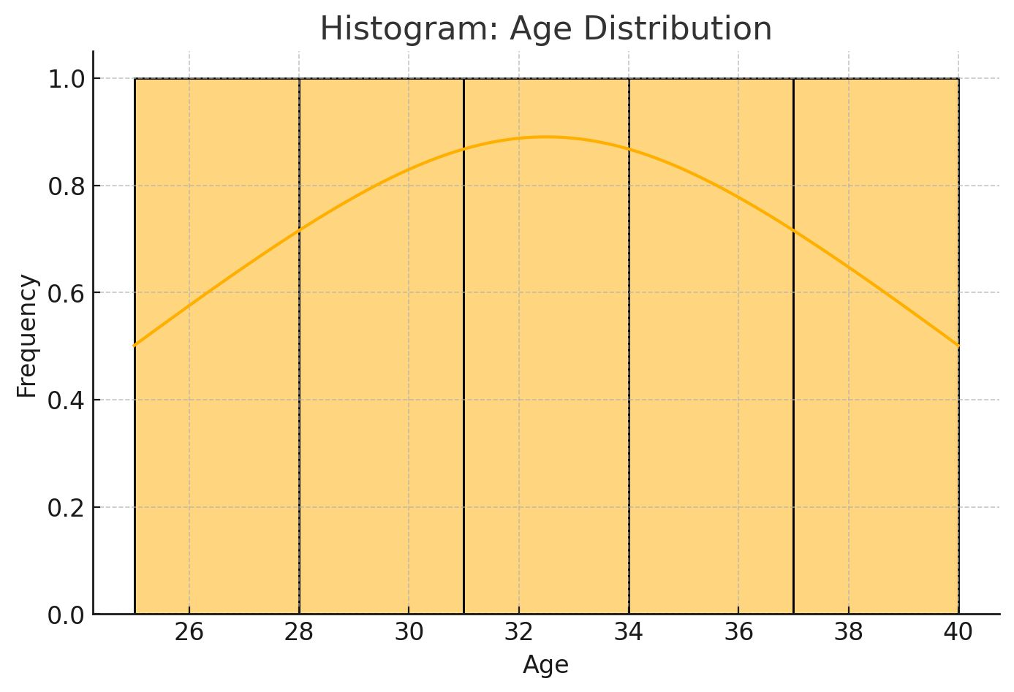
Histogram: Age distribution
We added a histogram of the age distribution to encounter the range of ages we are looking into according to the dataset.
The frequency on each age will make us understand how ages are distributed and how common each age is in the dataset.

Slide 8
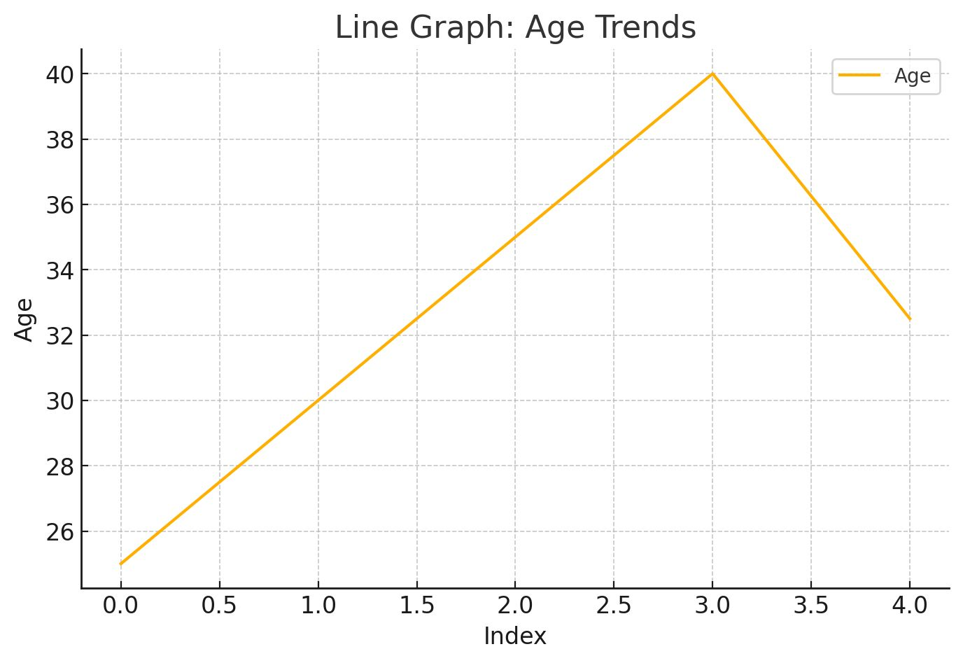
Line Graph:Age Trends
We used these line graphs for a variety of reasons such as displaying how people are affected with different diseases such as heart disease, obesity and diabetes with age. Also, we portrayed how the amount of exercise decreases with people overtime.

Slide 9
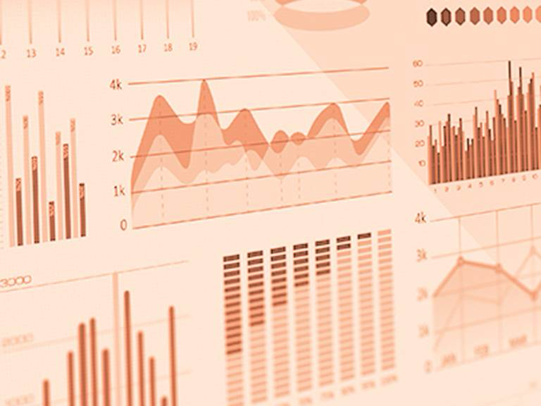
Data visualization improvements
Cleaned and processed the dataset to ensure accuracy.
Created multiple visualizations to analyze the data effectively, including:
Pie chart: we grouped small categories into “Other” and added a legend for clarity to make the chart easier to read.
Bar Chart: Improved readability by rotating labels, adding count annotations, and using a better colour scheme.
Line Chart: Showed trends over time for better insights.
Scatter Plot: We highlighted relationships between key variables.
Used Seaborn and Matplotlib for well-structured and visually appealing graphs.

Slide 10

Our Progress until Now
Using Jupyter notebook we’ve managed to have a closer look into the dataset and produce outcomes for each piece of data. Overtime, we will make our models much more complex as we are constantly learning new methods on presenting data and correlations. We will be lead on our outcome to view how different lifestyle variables can lead to certain health risks and a way on preventing them.

Slide 11
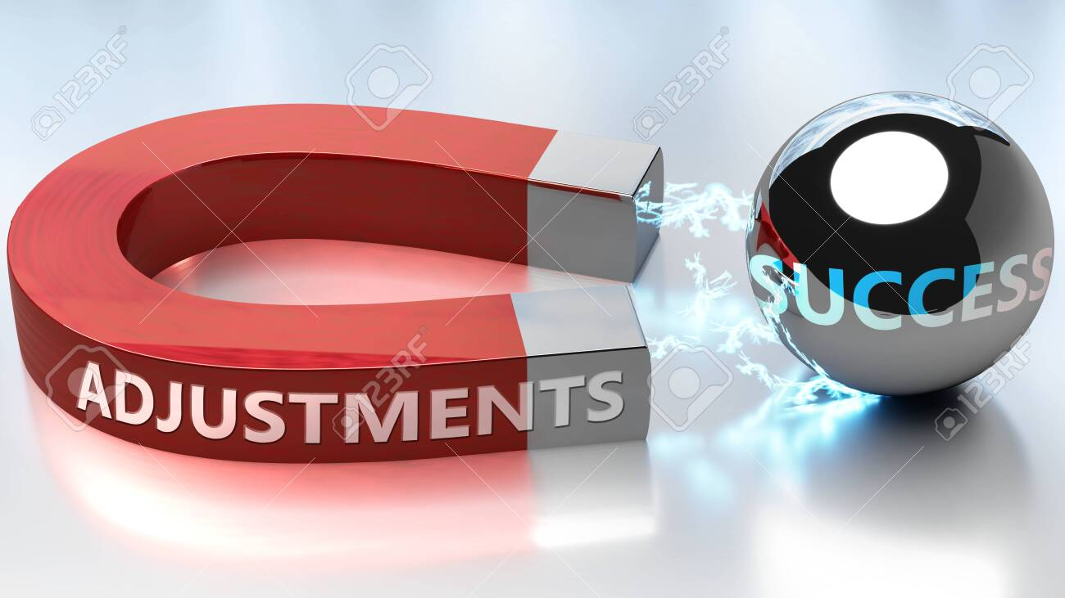
Adjustments we’ve made until now
We used line graphs:age trends for multiple diseases in relation to our previous plans which we were going to do that for obesity solely.
Used a large quantity of our dataset rather than focus on smaller chunks as we were originally planning to only have a look into diabetes but expanded our thoughts extensively to add heart diseases and obesity.
Lastly, our focus has drifted from looking into prevention techniques for each disease (this will be done last) to visualise the correlation between the diseases and people.

Slide 12
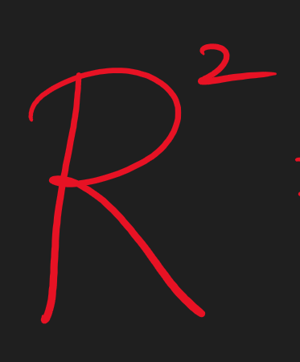
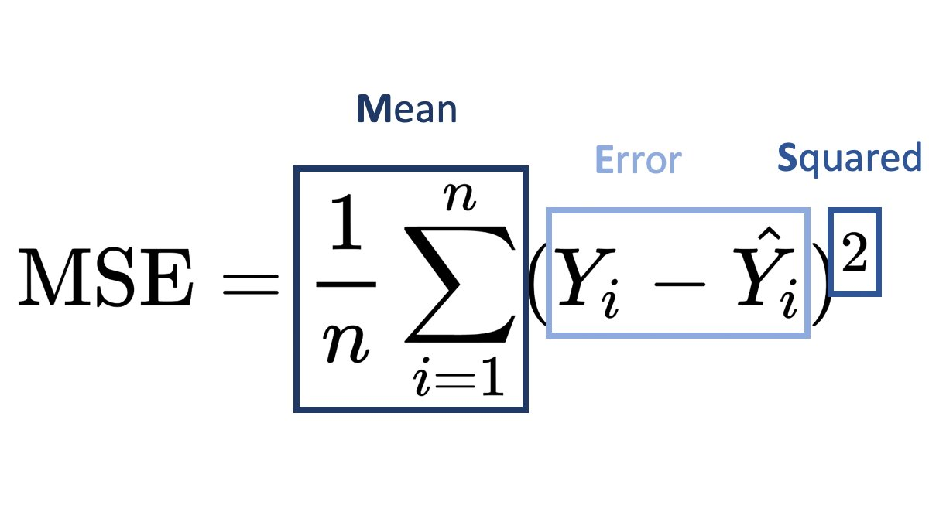
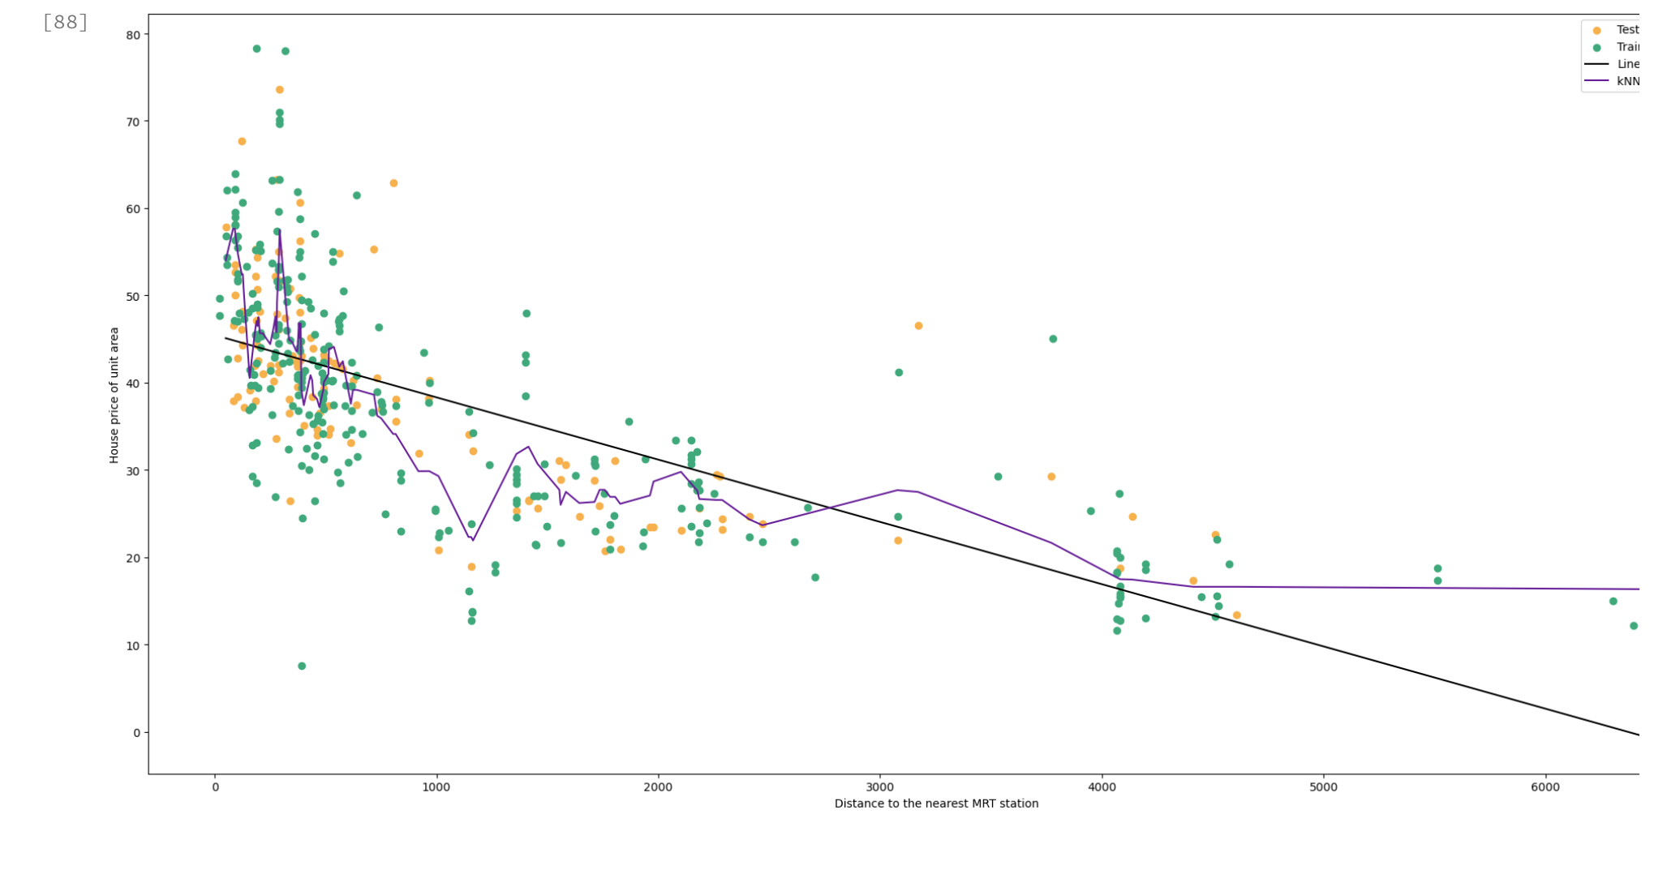
What we’re looking forward to
As our knowledge is progressing, we would like to integrate both linear regression and kNN in one graph rather than making two separate ones to plot the same concept.
We are also eager to have a look into other choices of loss function (Max Absolute Error, Mean Absolute Error and Huber Loss), we have already seen Mean Squared Error.
We will opt into using kNN in the majority of time when suitable as overall it has a lower MSE.
We will also utilise R-squared to evaluate our models.

Slide 13

Thank you for your attention!

